Slide 1

Montemorelos University
Faculty of Business and Law
PhD IN Business Administration
FACTORS THAT CONTRIBUTE TO GREATER CHURCH PERFORMANCE FOR THE
SEVENTH-DAY ADVENTIST CHURCH
by
Donald Paul

Slide 2
Research Question
Are Authentic Leadership, church spirituality, church culture and financial performance predictors of church performance as perceived by church officers of the Southeastern Conference of Seventh-day Adventists in Florida, USA?

Slide 3
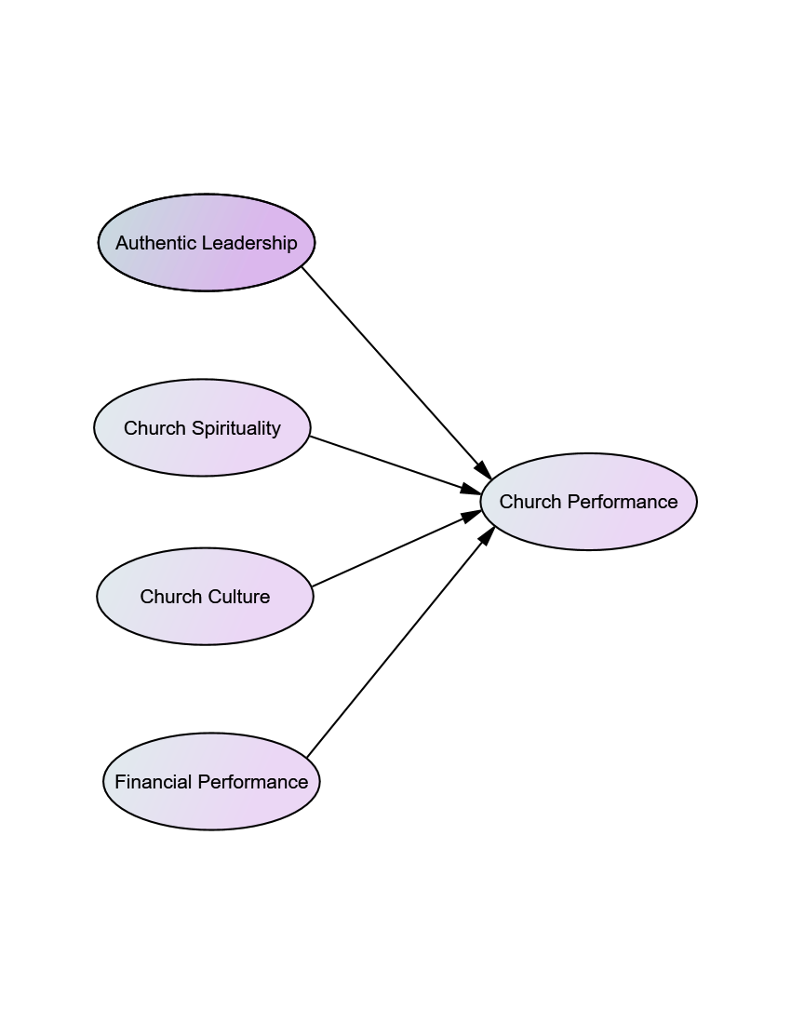
The Model

Slide 4
Hypothesis
H1. Authentic Leadership, church spirituality, church culture, and financial performance are predictors of church performance as perceived by church officers of the Southeastern Conference of Seventh-day Adventists.

Slide 5
Multiple Regression Assumptions:
The dataset was cleaned to ensure normality by the elimination of 8 data points leaving the dataset at 196 data points.
For this research the following criterion was analyzed:
  Linearity through the graphs.
  Test for the normality of the errors with the Kolmogorov-Smirnov statistic (p> .05), eight atypical data were eliminated.
  Independence of the errors was proved using the Durbin-Watson test, whose value is very close to 2, this indicates that the errors are not correlated and are independent.
  The homoscedasticity was analyzed and it was proven that the errors have equal variances.

Slide 6
Null Hypothesis
H0: The empirical model, in which Authentic Leadership, church spirituality, church culture, and financial performance are not predictors of church performance as perceived by church officers of the Southeastern Conference of Seventh-day Adventists.

Slide 7
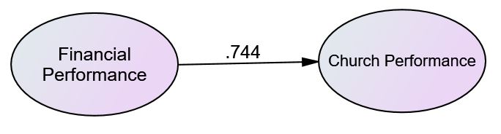
Results
By applying the method of stepwise in the regression analysis the following were observed:
Model 1:
The best predictor: Financial Performance
(Adj R² = .551)
F value =240.273 and p value =.000.
As it can be observed that the p value is less than .05, therefore, there is a positive and significant lineal correlation. Thus, the null hypothesis is rejected.

Slide 8
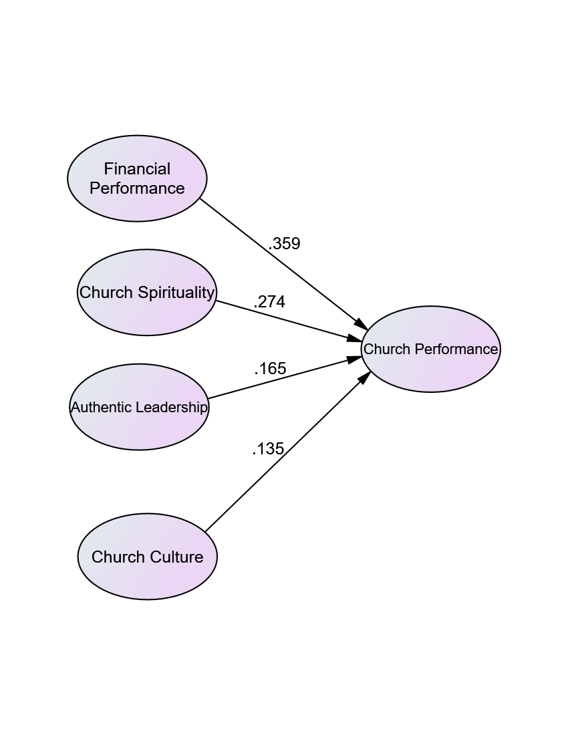
Model 2

Slide 9
Results
The best model: Financial Performance, church Spirituality, Authentic Leadership, and church culture because they explain 64.5% of the dependent variable.
F value =89.583 and p value =.000.
As it can be observed that the p value is less than .05, therefore, there is a positive and significant lineal correlation. Thus, the null hypothesis is rejected.

Slide 10
Results Cont.
R=.808
Adjusted R² =.645
F(4,191)=89.583 P=.000 Good model
a =.580 P=.002
b1=.344 P=.000
b2= .252 P=.000
b3=.150 P=.007
B4=.110 P=.020

Slide 11
Results Cont.
Y=a+b1x1+b2x2+b3x3+b4x4
Y= .580+.344(x1)+.252(X2)+.150(x3)+.110(x4)
VIF ≤ 4 (2.526, 2.522,1.992,1,793)
No Collinearity.

Slide 12
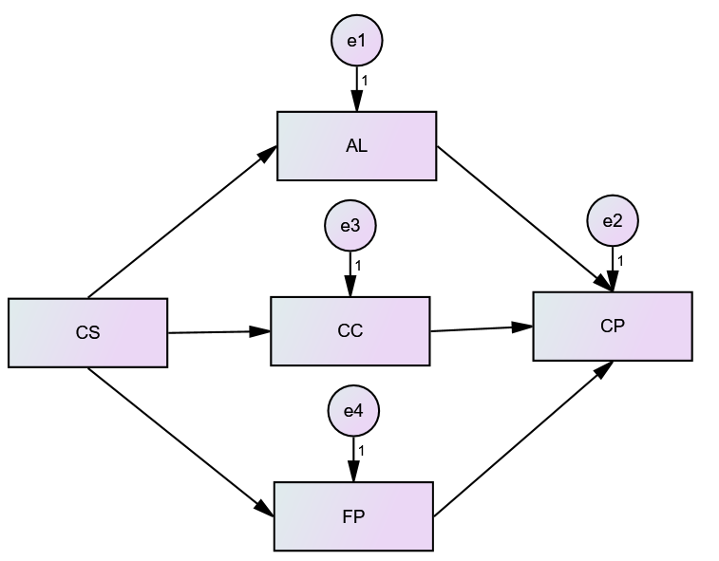

Structural Model

Slide 13
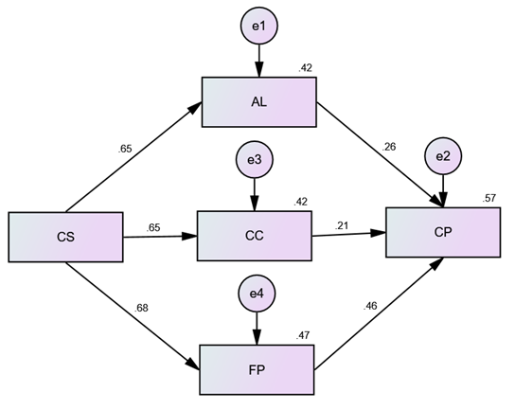
Results
By running the data in Amos the following were observed:
Model 1:
Results of the empirical model (X² = 53.715, p = .000, RMSEA = .256, GFI = .887, NFI = .903, and CFI = .908).

Slide 14
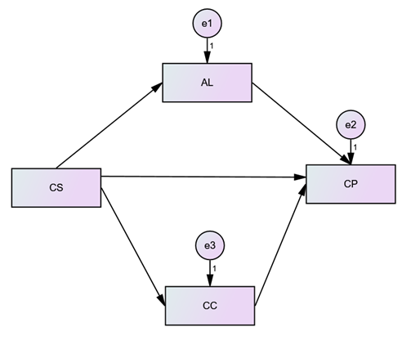
Results
Model 2:
The null hypothesis was test again (without FP)

Slide 15
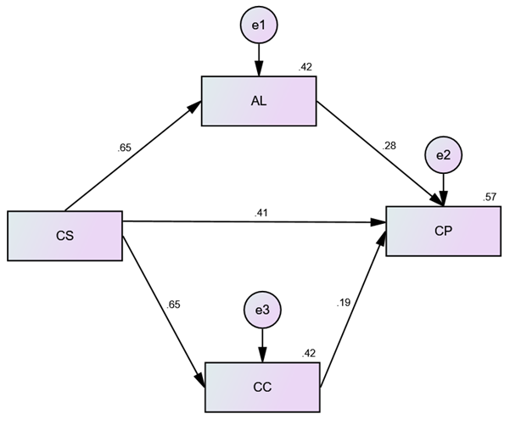
Results
Model 3:
Results of the empirical model
(X² = 6.124, p = .013, RMSEA = .165, GFI = .984, NFI = .984, CFI = .986).

Slide 16
Thank You!

